Slide 1
CSE315:Introduction to Data Science
WEEK-6

Slide 2
Probability Distribution
Probability distribution is the spread of probability. Probability distribution is an excellent way to make a decision. Through this we can easily understand what is the strongest event?
Suppose a patient has several symptoms. These symptoms are similar to multiple diseases. In this case, if we use probability distribution, we will see which disease has the most resemblance. In this way it is easy to understand which disease is more likely to occur in this patient. Probability distribution is a kind of decision making tool that we can use to make many decisions in the real world very easily.

Slide 3
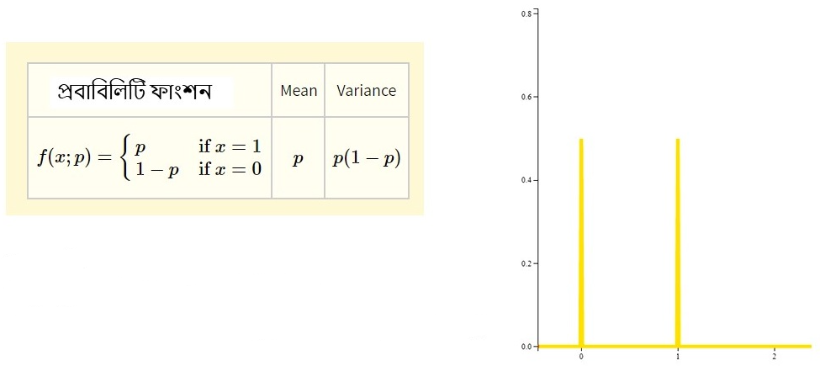
Barnauli Distribution
The most perfect example of Barnauli distribution is the coin toss. Only two events occur in the coin toss experiment. Outcome as head or tail as outcome.
Two outcome-based experiments follow this distribution. The probability of one event is p and the other event in this distribution is 1− p. Barnauli distribution is Discrete Probability Distribution.

Slide 4
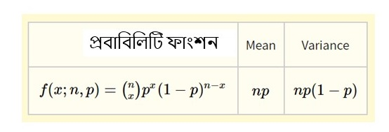
Binomial distribution
The idea for binary distribution came from the Binomial distribution. The binary distribution specifies how many times the experiment will be performed. This is also a kind of discrete probability distribution.
A hospital database shows that 75% of the total patients die from a particular disease. If 6 patients with this disease are randomly selected, what is the probability of 4 of them surviving?

Slide 5
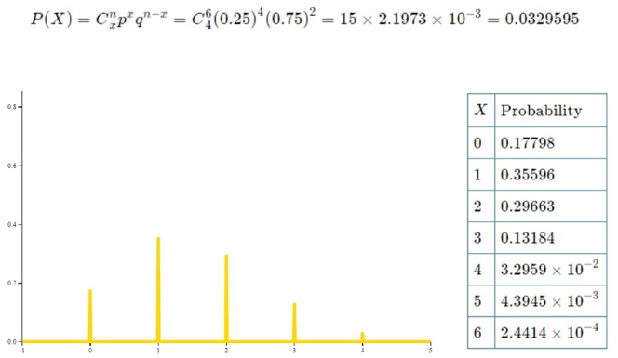
Binomial distribution Example
Given that
Trial number = 6 Probability of survival = 0.25
Probability of death = 0.75
In the chart, we can see that the probability that 4 people will survive is 0.3295.
The probability that one person will survive is the highest and
the probability that 6 people will survive is the lowest.
In this way we can determine the probability of all possible events.

Slide 6
Poison Distribution
A special feature of Poison Distribution is that it has a certain interval. That is, the probability of how many times an event can occur within a certain interval can be distributed. This parameter expresses the mean value of 8 parameters. And x expresses the number of events. It is possible to find out how many goals can be scored in such a football game by this distribution.
Example- The probability of making a faulty motor in a motor made by an electric motor manufacturing company is 0.01. If 300 motors are selected randomly, 5 motors will be defective in it. What is its probability?

Slide 7
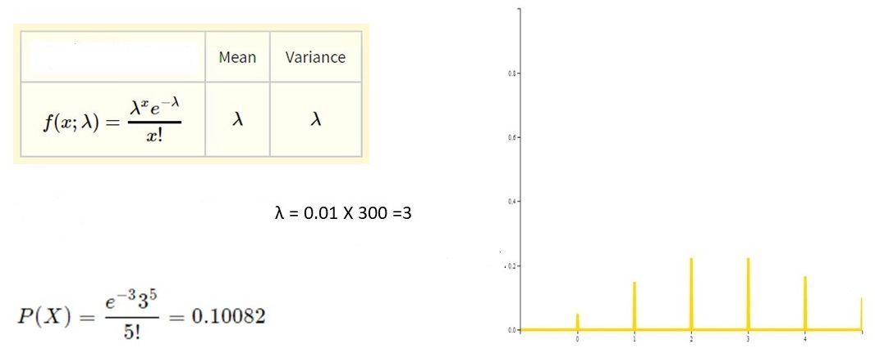
Poison Distribution Example
Probability Function
Defected Motor Average Number
Probability of getting 5 defective motors out of 300

Slide 8
Normal Distribution
The shape of a normal distribution is much like a bell or bell, which is symmetrical, that is, equal on both sides. In real life, normal distribution is seen in many things. Normal distribution is symmetrical, meaning that Mean, Mode, and Median are in the middle, with equal amounts of data on either side. This is a continuous distribution.
Example: The average hourly wage of a company employee is 3.25 with a standard deviation of 60 cents. What percentage of the company’s employee salaries range from $ 2.75 to $ 3.69?

Slide 9
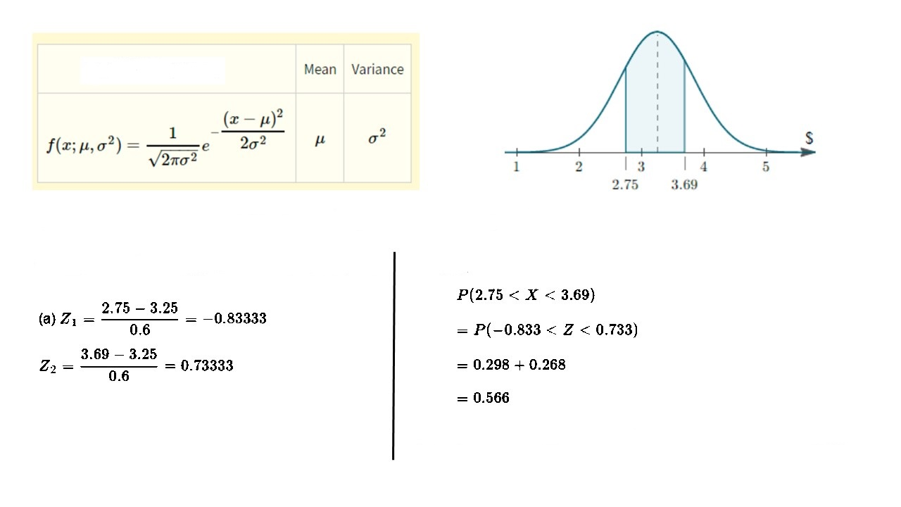
Normal Distribution Example
Probability Function
Average hourly wage is 3.25 with a standard deviation of 60 cents
So, the salary between $ 2.75 to $ 3.69?
So,
So, the salary between $ 2.75 to $ 3.69 is 56.6%

Slide 10
Exponential Distribution
Exponential distribution is a kind of continuous distribution. Suppose a person buys a machine for his factory. At first, however, the machine is less likely to malfunction. The chances of the machine malfunctioning will also increase over time. As the years go by, the chances of the machine malfunctioning will also increase. Basically such incidents are published through Exponential Distribution.
Example - Suppose the average lifetime of a device is 10 years. What is the probability that the device will be active for at least 7 years?

Slide 11
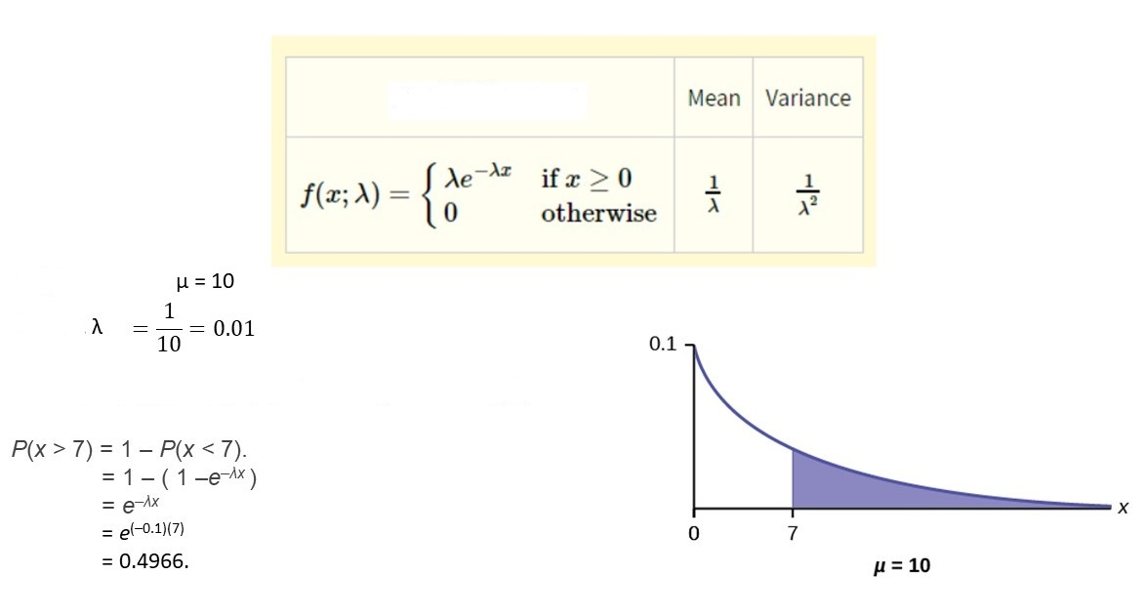
Exponential Distribution Example
Probability Function
Average Lifetime
So,
Probability of the device will be active for at least 7 years

Slide 12
Where is the method appropriate?
It is not logical to use mean if there is an outlier in the data.
In the case of categorical data, neither Mean nor Median makes sense. In this case, the use of mode may make sense.
Median is quite effective in the case of continuous data.
In the case of regression model, it is sometimes meaningful to fill in the missing value by 0. The general method does not make sense in the case of time series data, in which case the moving average or other methods can be used.

